Slide 1

Beyond the Bite
What shark incident data really tells us
Team Serie: Ailixier, Amanda, Berker & Tina
Notes:
Hello everyone.
I am Amanda and together with Ailixier, Berker and Tina, we are representing Save Our Sharks, which is shark conservation organization in the US and we’re working to challenge the idea that sharks are bloodthirsty killers.

Slide 2
Challenging the myth
We are Save Our Sharks, a U.S. shark conservation NGO running an awareness campaign to challenge the perception that sharks are bloodthirsty killers.
Public fear of sharks is greater than the actual danger they present. Since the release of Jaws in 1975, sharks have been widely feared and misunderstood. In reality, only a small fraction of shark species pose any risk to humans, while sharks play a vital role in maintaining healthy ocean ecosystems.
Using the Global Shark Attack dataset, we will investigate the fatality rate and understand if these shark attacks have been provoked or unprovoked by humans. We will compare the shark incidents over the last 50 years to see if there has been an increase. We aim to understand if this shark aggression is caused by growing human populations, greater beach activity, and increased overlap between humans and shark habitats.
Our goal is to separate fear from fact and better understand the true nature of shark-human interactions.
Notes:
When people think about sharks, they often think of danger and shark attacks. But popular culture and media coverage like the release of the movie Jaws, can sometimes make the risk seem much greater than it really is.
In this presentation, we'll use data to explore what shark incidents actually tell us. We'll look at patterns in shark attacks, fatality rates, and trends over time to separate fear from fact and better understand shark-human interactions.
Using the Global Shark Attack dataset, we investigated how many incidents are fatal, whether they are provoked or unprovoked, and how incident numbers have changed over the last 50 years.
Our goal is to use data to better understand the reality behind shark-human interactions.

Slide 3
Understanding the data
We looked at the Global incident log of shark attacks dataset of 7090 entries and discussed which columns to include and exclude in our analysis.
We identified the following columns based on the questions we wanted to answer:
Type - What proportion of shark incidents are unprovoked vs. provoked?
Fatal - How many incidents are actually fatal?
Species - Which species are involved — and are they truly dangerous?
Species - Which species appear in fatal vs. non-fatal cases?
Year - Has the number of incidents increased over time — and if so, why?
Gender - Does gender play a role in shark incident patterns?
Activity - What are the types of the incidents?
State - Is there a state with a much larger percentage of incidents?
Notes:
Our dataset contains over 7,000 recorded shark incidents from around the world.
To answer our research questions, we selected several key columns.
We used Type to compare provoked and unprovoked incidents, Fatal to measure risk, and Species to identify which sharks are involved.
We also looked at Year to analyze trends over time, Gender and Activity to understand who is affected and what they were doing, and State to explore geographic patterns.
These variables help us investigate whether public fears match the data.

Slide 4
Dataset problems
On closer inspection we realised that there were some problems with the dataset, namely:
Missing values
Understanding how to deal with the missing values in df.
Formatting issues
Understanding if the data is standardized and readable.
Inconsistent data
Understanding if the data is accurate.
Notes:
Tina
Missing values
State - 7 null State entries with the US. Statistically small number so we decided to drop these rows
Type - 18 null entries
Sex - 578 null entries
Species - 3131 null entries
We acknowledge that correctly identifying the species during a shark attack is quite challenging since it relies on descriptions by the victim or by other witnesses to the event.
Fatal - 561 null entries and additional 71 that were categorised as Unknown. We replaced Unknown with NaN to group these all together.
Year - 2 null entries
Formatting issues
Mix of lower and uppercase. We standardized everything to lowercase.
Trailing whitespace in column names and values.
Renaming values under different columns to structure everything logically.
Inconsistent data
State
Inconsistent state names and formatting. For example 'North & South Carolina' vs ‘North Carolina and South Carolina or Carolina coast (North or South?). Combine all in Carolina may be better
Country
Inconsistent country names and formatting. replace invalid entries with 'NaN' to represent missing data and we replace inconsistent countries
Type
Provoked vs Unprovoked. We looked at the Injury column to get more detail on how the type was classified as provoked vs unprovoked. For example if the shark was hooked or netted it is classified as provoked.
Watercraft – This shows incidents in which a boat was bitten or rammed by a shark and no injury to a person was recorded.
Questionable incidents - Incidents in which there are insufficient data to determine if the injury was caused by a shark or the person drowned and the body was later scavenged by sharks. Because we don’t know, we have grouped these incidents as Unknown.
Invalid - Shows the incidents that are not clear why/how it happened.
Species
We scanned the “Species” column and applied a keyword-matching logic for specific identifiers, such as “white” for White Sharks, “tiger” for Tiger Sharks,”bull” for Bull Sharks to categorize records accordingly.
Reports with vague or speculative descriptions(like:”unknown” ,”large shark”) were grouped as “Unknown” to maintain data integrity.

Slide 5
Cleaning process
We identified the main columns we needed for analysis and applied the following cleaning techniques:
Removed white space
Replaced missing values with Unknown
Combined similar values together
Standardized everything to lowercase
Dropped columns we didn’t need
We made some important transformations for example:
Converted results into percentages to be able to better analyse the data
Grouped Species into 4 main categories
Using pivot tables to get a better view of the results
Structural decisions
Filtering out only USA, excluding territories (for example Puerto Rico, virgin islands)
Grouping the years to before and after 1975
Notes:
Tina

Slide 6
Data structuring
We created new variables in our data frame in order to support our analysis
Changed data type where necessary, for example, from object to string
Groupings and aggregations techniques to organize the data around the key questions we wanted to answer
Final dataset organization: Clean, structured, and ready for analysis
Notes:
Tina

Slide 7
Major challenge
Qualitative data in open text fields makes analysing and reporting on data very difficult because of the large number of unique entries, for example “injury” and “species”.
Some of the values under "Type" column were not clear - provoked, unprovoked. So, we looked at "injury" and "species" column and there were some useful information which lead us to drop some values completely from the data frame.
Some columns have messy values.
Analysing data that has a correlation does not necessarily mean causation. For example, more incidents happened after the Jaws was released, does not mean that the movie is responsible for this. Understanding that we don’t know the answers to all the Why’s and that often further research is needed.
Notes:
Berker
One of our biggest challenges was dealing with open text fields in the dataset. For example the Species column had over 600 unique entries — things like 'large shark, approximately 8 feet' or 'suspected white shark'. And these made the analysis nearly impossible until we grouped them into four clean categories using keyword matching.
The second challenge was the Type column. Some values like Questionable, Invalid and Sea Disaster weren't clear attacks at all. So instead of just dropping them blindly, we cross referenced the Injury and Species columns to confirm our decisions. We found some values in those columns which helped us to understand where those actually belong in type column.
Another challenge was that some columns had messy values. Such as State column having some lowercase/uppercase issues and having country values inside. So, we had to clean up and structure properly before we start the analysis.
Last but not least, we can consider this as a general challenge for almost all the data frames. Analysing the data that has a correlation does not necessarily mean causation. So, we had challenges answering WHY and HOW questions while making the analysis.

Slide 8
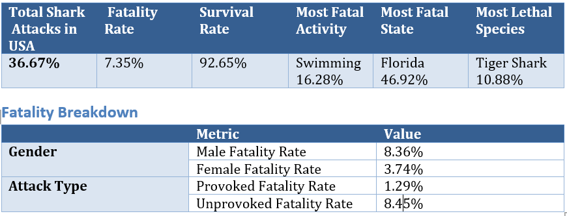
Final insights
Conclusions
Our data shows that most of the encounters are not fatal. Unprovoked incidents carry a fatality rate of 8.45%, Although, it is 6 times higher than provoked incidents at 1.29%, it's only fatal at this level. If sharks were bloodthirsty killers, they wouldn't leave almost 92% of their unprovoked encounters alive. Even the most feared encounters are rarely fatal.
Potential applications
Launch the awareness campaign in Florida, since they have the highest percentage of shark incidents
Conduct further research on shark migration patterns for the bull shark, tiger shark and white shark to better understand these species that are involved in many incidents
Use verified statistics to debunk the myth of "increasingly aggressive" shark behavior.
Notes:
Berker
So what does the data actually tell us? Out of over 2,300 recorded shark incidents in the USA, the vast majority were not fatal. Even unprovoked attacks — where the shark approaches completely on its own — are only fatal around 8% of the time. That means sharks had every opportunity to kill and chose not to, 92% of the time.
We found out provoked incidents at just 1.3% fatality rate. So, when humans trigger the interaction, sharks are still rarely killing. This directly challenges the idea that sharks are aggressive predators and basically the data tells a very different story.
Based on our conclusions, we could launch some potential applications as an organization. Such as;
Launching the awareness campaign in Florida, since they have the highest percentage of shark incidents with almost 50%
Conducting further research on shark migration patterns for the bull shark, tiger shark and white shark to better understand these species that are involved in many incidents
Using verified statistics to debunk the myth of "increasingly aggressive" shark behavior.

Slide 9
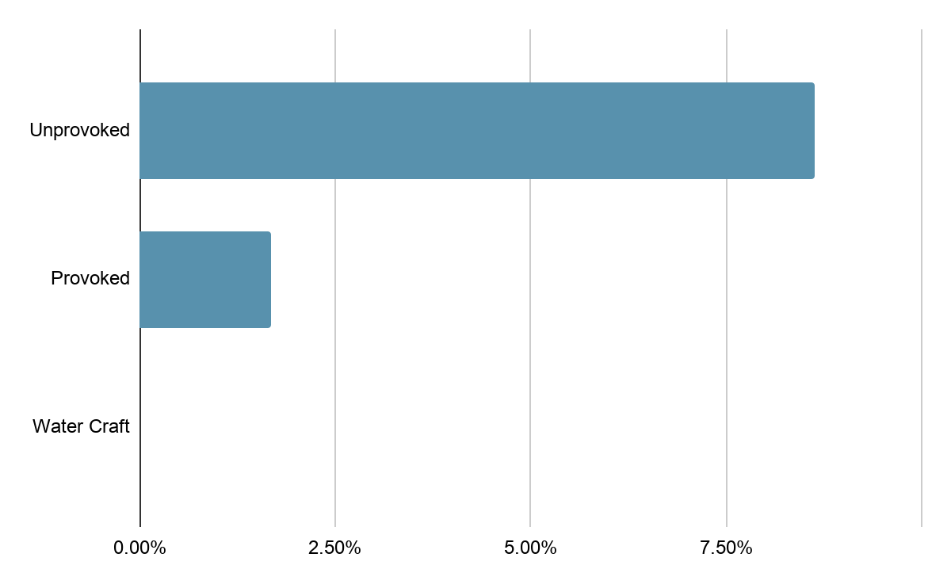
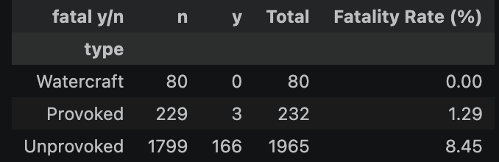
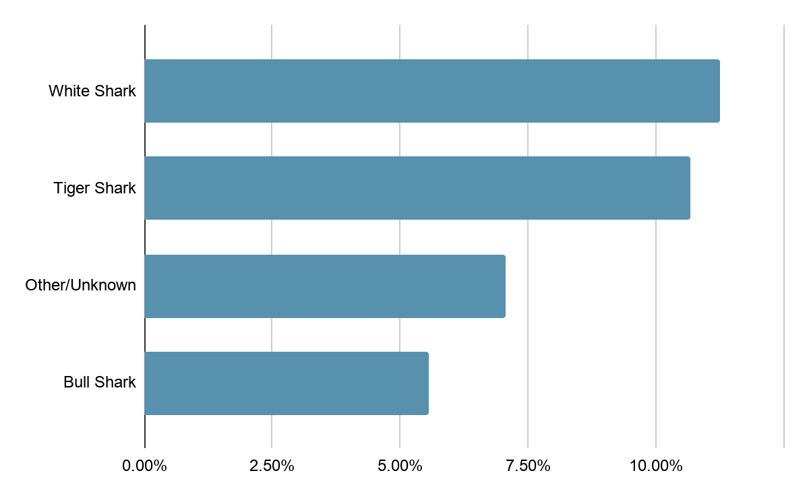
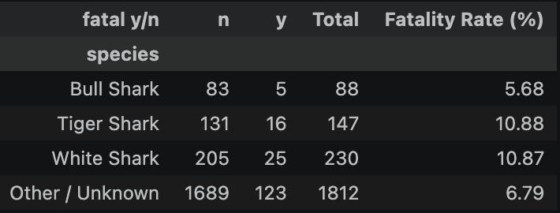
Final insights
Type: What proportion of shark incidents are unprovoked vs. provoked? And what is the fatality rate?
Species:Which species are involved — and are they truly dangerous?
Notes:
Ailixier
Let's look at the type data , most incidents are classified as 'Unprovoked.' This sounds scary, but it actually means the shark didn't have a clear reason to attack—it was likely just confused, or it mistook a human for its natural prey, like a fish or a seal. The high number of 'Unknown' species also shows that these events are usually quick, blurry, and unpredictable. In short, the data suggests that these are not intentional attacks, but simple cases of mistaken identity.
Second, look at the species data. Even for these major species, the fatality rate is around 10 percent. This means 9 out of 10 people survive these encounters. This is not what we’d expect if they were truly 'hunting' humans.

Slide 10
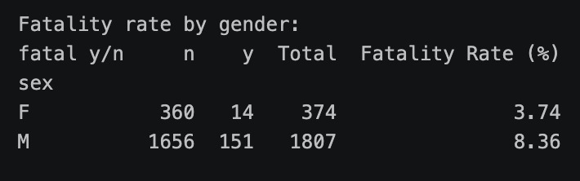

Final insights
Gender - Does gender play a role in shark incident patterns?
Year - Has the number of incidents increased over time — and if so, why?
Notes:
Ailixier
our gender analysis shows that males are involved in far more incidents than females. Does this mean sharks prefer men? Not at all. It points to a behavior gap: males are more likely to participate in high-risk activities in the water, such as surfing or deep-water swimming.
Second, look at the timeline. Incidents after 1975 are much higher than before. However, this does not mean sharks have become more dangerous. Instead, this data reflects two major changes: the global boom in coastal tourism since 1975, and the improvement of modern reporting systems. Simply put, as more people head into the water, the chances of encountering a shark naturally increase. This shift is driven by changes in human activity, not by any change in shark behavior.

Slide 11
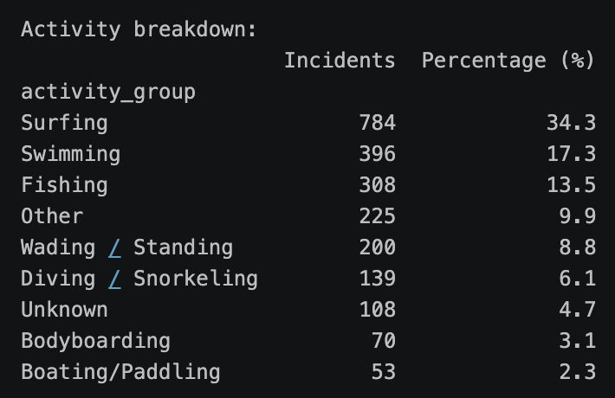
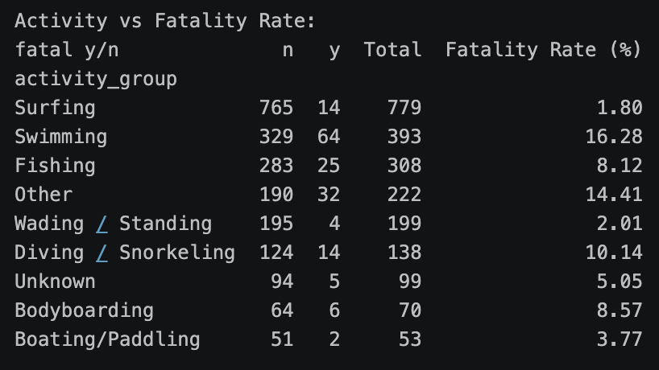
Final insights
Activity - What are the types of the incidents? Surfing and swimming
Notes:
Ailixier:
Finally, Look at the activity breakdown. Surfing accounts for over 34 percent of all incidents, which is the highest. But notice the fatality rate—it’s very low, at only 1.8 percent. We found that fatality rates are significantly correlated with activity types. While surfing is the most frequent activity, it has a surprisingly low fatality rate—likely due to the safety barrier provided by the surfboard. In contrast, swimming poses a much higher risk, as swimmers are more vulnerable in the water.

Slide 12
Changing the narrative
Before the data:
"Sharks are bloodthirsty killers."
After the data:
"Sharks are wild animals sharing an ocean with an increasing number of humans."
By replacing fear with facts, we can help build public support for shark conservation and protect a species that plays a vital role in marine ecosystems.
Save Our Sharks
Protecting sharks starts with understanding them.
Thank You 🦈
Ailixier, Amanda, Berker & Tina
Notes:
Berker
Finally, why do incidents happen at all? The data confirms that incident numbers are driven by human behaviour and habitat entrance. So, not by sharks becoming more aggressive.
By replacing fear with facts, we can help build public support for shark conservation and protect a species that plays a vital role in marine ecosystems.
Lets save our sharks and we can only protect sharks starts with understanding them.
Thank You 🦈

